Slide 1
Dubbizle case study
Harika Munnaluri
20th May 2018

Slide 2
Motivation
To increase user-engagement on the website
Utilizing user queries helps capturing similarity better
Adapting the ranking function, which controls the trade-off between similarity and quality, to a specific context improves recommendation performance

Slide 3
Key-ideas
The recommender systems consists of two processes
Offline process – generates long term clustering using the short lived listings
Clusters are built on the user queries and hence takes into how user groups the items
Separate clustering process is built for each query and there by process is run in parallel ensuring the efficiency of the process
Online process – utilizes the clusters from offline process and next conducts a trade-off between similarity and other quality factors such as seller trustworthiness

Slide 4
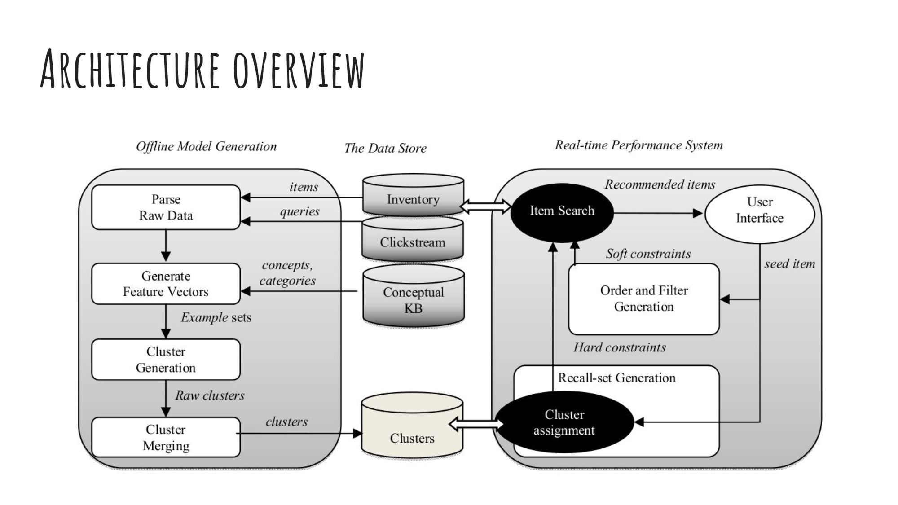
Data flow representation

Slide 5
Offline process – clusters generation
User query Selection - Set of frequently used user queries are selected
The system mines the frequency of every query (demand) and the average number of items (supply) and selects queries where demand and supply meet a minimum threshold
Item Feature Vector Generation
Tokens extracted from item titles are used as features
It also allows for the user to enter attribute-value pairs
Once the features are extracted, the input item is represented as feature vectors with weights using the Mutual information shared by feature and category
Parallel clustering of queries
The selected user queries are considered as base clusters from which more granular clusters are created
Bisecting K-means clustering is used to bisect the base clusters
Bisecting starts with base clusters and sub-clusters are created which maximize intra cluster similarity and minimize inter-cluster distortion

Slide 6
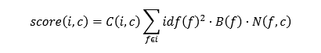
Offline process – clusters generation
Merging clusters – Generating the clusters in parallel may duplicate the clusters
Non-overlapping clusters – They represent different inventory groups within inventory. So no action required
Overlapping clusters – They have some overlap but not duplicates. We keep both clusters, if they capture significant inventory
Duplicates – They cover the same item inventory or nearly same. In this case, we remove the smaller cluster
Parent-child – One cluster is contained within the second. In this case, we keep both mark the parent-child relationship
Cluster Assignment service
It assigns one or more clusters to an input item. This is done by indexing clustering definitions using a Lucene index* which retrieves clusters based on seed item’s features

Slide 7
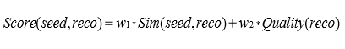
Real-time performance system
Cluster based hard constraints for recall
For a given seed item, it first retrieves n best matching clusters. This is based on fuzzy matching process maximizing the intersection of seed item tokens and cluster tokens
Then a set of matching tokens are created
Soft constraints for ordering
Ordering is applied only to the small portion of the items
The ranking function is the weighted average of similarity and quality as below

Slide 8
Comparison between SIR and other IR techniques
The other IR systems are similarity based and gauges mainly into user interest in an item and recommends the items similar to that of the features of the seed item. For a large market place where majority of the items are short lived, pre-computing using techniques like collaborative filtering is not feasible. In an open market setting, there is also need to consider quality factors like item quality, seller trustworthiness etc. and negotiate a trade-off between similarity and quality
The similarity-item recommender system is based on the following ideas:
Using a hybrid method, which takes into account quality like trustworthiness of seller, item quality etc.
The recommender systems like collaborative filtering and naïve method don’t take into account user queries but the latest approach considers the user queries to build the item clusters
Efficiency as separate models are built for each user query in a parallel way

Slide 9
Shortcomings of The APPROACH
SIR focuses on small set of items that match the best clusters for the seed item, while NIR considers all the items
It will be computationally intensive to choose a larger set of items
SIR can fail if a bad quality measure is chosen
It can also perform poorly based on the weights chosen for quality and similarity

Slide 10
Possible extensions
Personalized recommendations
Users can be segmented into groups based on their behavior into specific, experimental, quality specific etc. and in turn can provide user-specific recommendations
Understanding the user-friendliness of the recommendations and change the weights if the historical recommendations didn’t perform well

